Slide 1
Linear Equations in Linear Algebra
1.5 Solution Sets of Linear Systems
Bumhee Cho

Slide 2


Homogeneous Linear Systems
always has at least one solution
trivial solution
nontrivial solution
if and only if the equation has at least one free variable
Theorem 2. Existence and Uniqueness Theorem
If a linear system is consistent, then the solution set contains either (i) a unique solution, when there are no free variables, or (ii) infinitely many solutions, when there is at least one free variables.

Slide 3
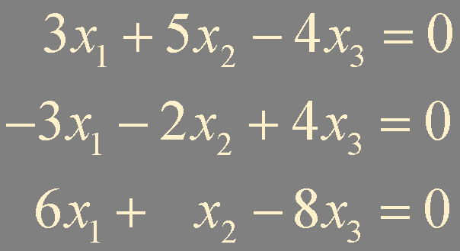
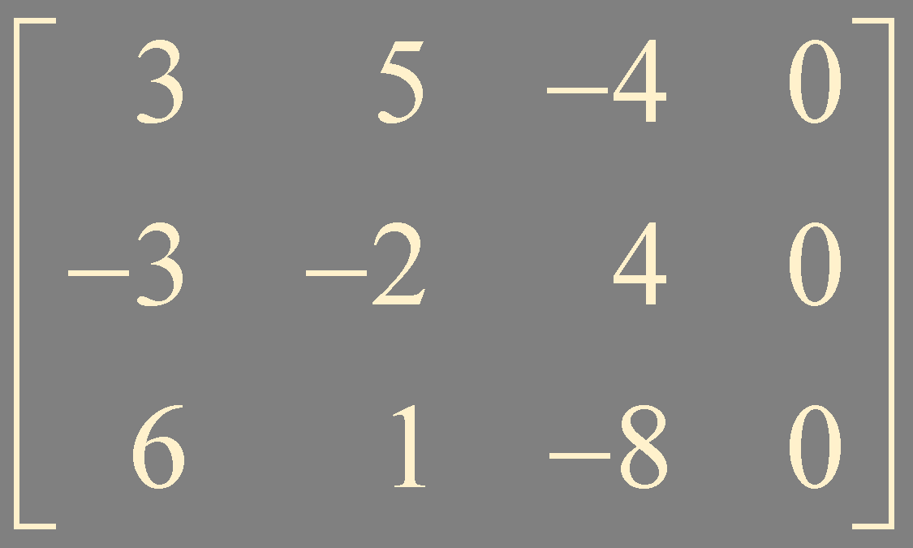
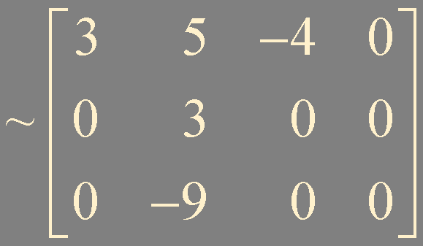
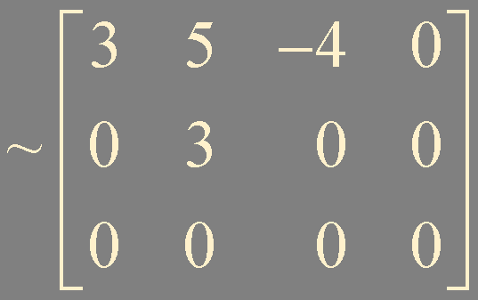
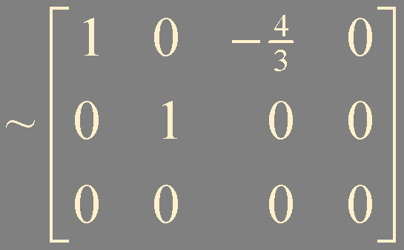
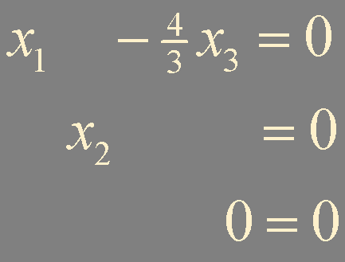
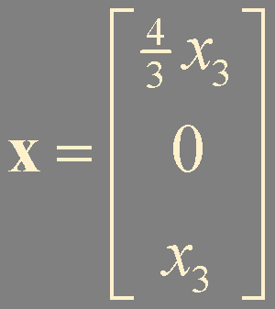
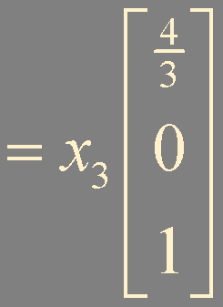
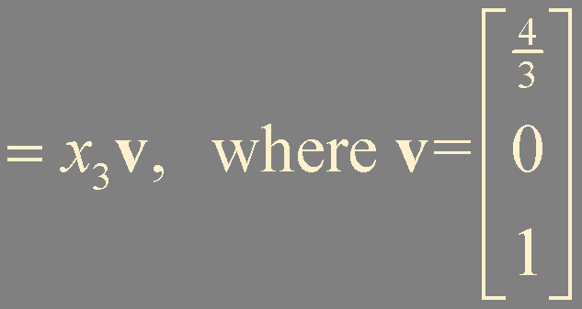

Example1. Determine whether there is a nontrivial solution.
line !

Slide 4

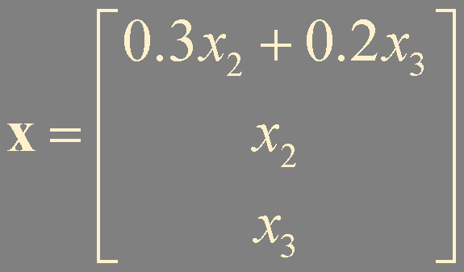
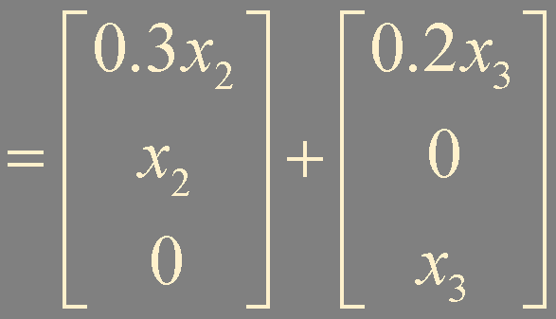
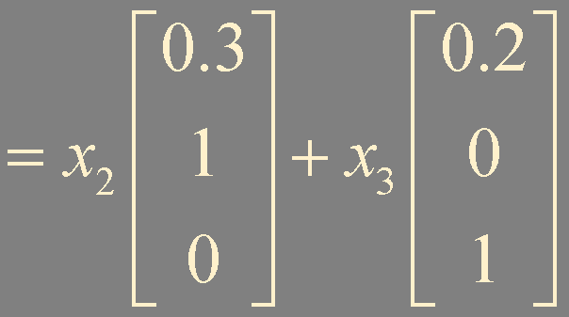



Example2. Determine whether there is a nontrivial solution.
plane !

Slide 5


the solution set can always be expressed as
trivial solution

Slide 6



Nonhomogeneous Linear Systems

Slide 7
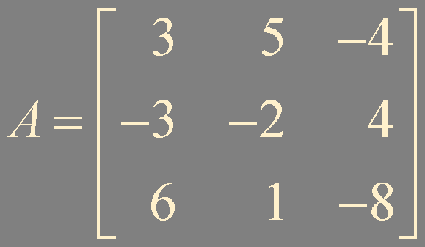
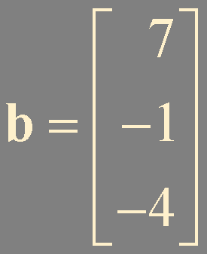

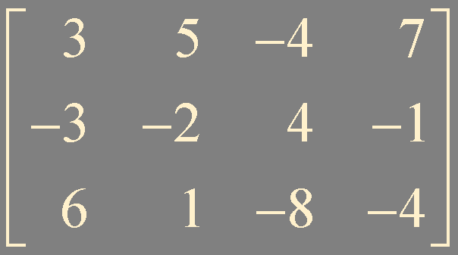
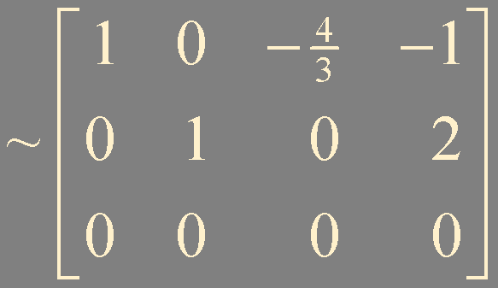
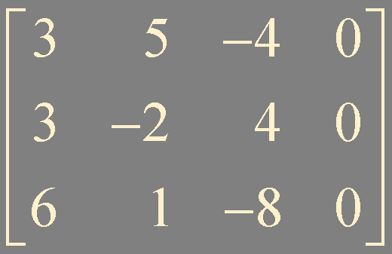
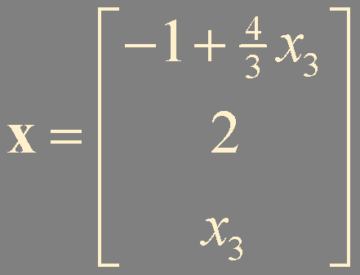
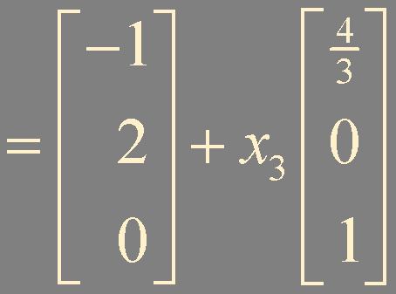
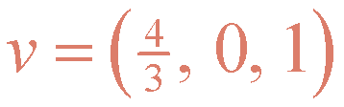


Example3. Describe all solutions
Example1.
particular solution
homogeneous solution

Slide 8


Theorem 6.
Suppose
is consistent
and let
be a solution
Then the solution set of
is the set of all vectors of the form
where
is any solution of the homogeneous equation

Slide 9






Example4. Understanding Theorem 6. in ℝ³
O

Slide 10
Summary
homogeneous system: trivial solution / nontrivial solution
nonhomogeneous system
Theorem 6.

